Slide 1
Fire Detection and Notification Method in Ship Areas Using
Deep Learning and Computer Vision Approaches
Mitheela Das Armisha
23273003

Slide 2
INTRODUCTION
Ships is the oldest model of transportation have aided humanity in many aspects of life.
Threat of fire is common incident in ship.
The risk to the crew and passengers is increased if the cargo contains extremely flammable substances like coal, wood, oil, or gas.
Impacts on the safety of the crew, cargo, the environment, finances, reputation.
DATASET-
collected 4622 images of various ship scenarios and performed data augmentation techniques.

Slide 3
Introduction(continued)
The aims of this research project-
showcases enhanced capabilities of fire recognition to improve maritime safety using YOLOV7.
Real-time fire detector in challenging environments and for small-object detection.
Protection of ships and in monitoring fires in ship port areas.
Detect image is different light condition.
Proposed Work
Collect different size of picture videos to increase the size of dataset.
To give accurate accuracy of system use this picture and distinguish video.

Slide 4
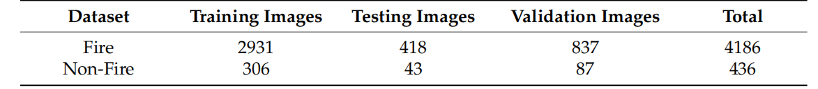
Proposed work(continued)
Illustration features fire items, flames, and burning displays use public platforms such as Roboflow and Kaggle.
Containing both diurnal and nocturnal images dataset reached a total of 4186 images of fires and 436 images of non-fire scenarios were added to expand the diversity of the dataset.
70% training, 10% test,20% validation.

Slide 5
Methodology
YOLOV7
The evolution of YOLO models is typically based on the accuracy and speed of the algorithm.
For the detection and recognition of small objects, YOLOv7 is preferable to YOLOv6 .
YOLOv7 uses an E-ELAN architecture as the backbone of the algorithm
It utilizes gradient flow propagation paths for determining the segments (modules) within the overall model that requires re-parameterization.
A major advantage of YOLOv7 over its antecedents is its speed and accuracy, which empower it to perform object detection more precisely and accurately.

Slide 6
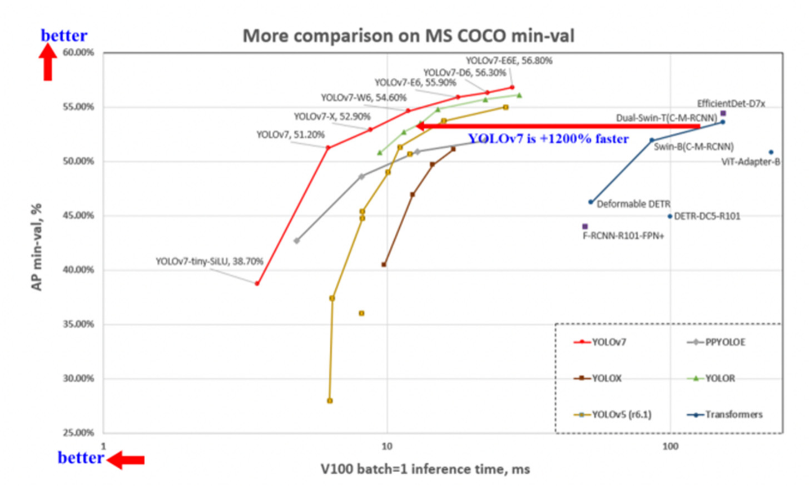

Slide 7
Methodology(continued)
Fire Detection Using YOLOv7
First YOLOv7 separate the input image in n grade,all same size.
Predicted objects in each grid are overlapped from the increasing predictions of the grid.
The YOLO architecture uses a mechanism to predict only objects of interest, called non-maximal suppression.
YOLOv7, unlike its peers, scales the depth and width of the network simultaneously while connecting layers together.

Slide 8
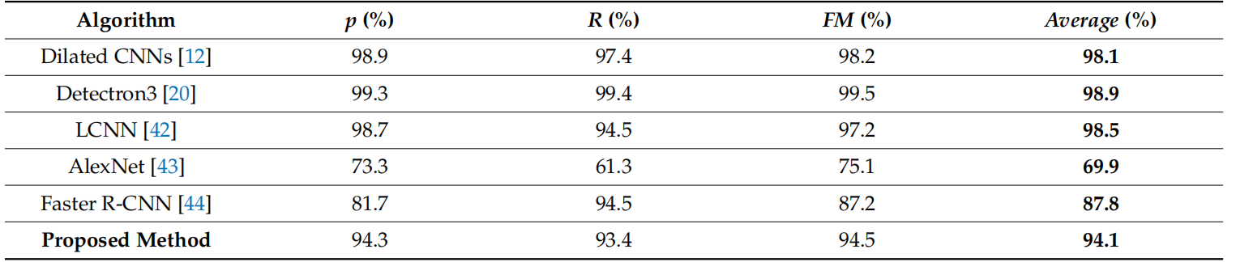
Result

Slide 9
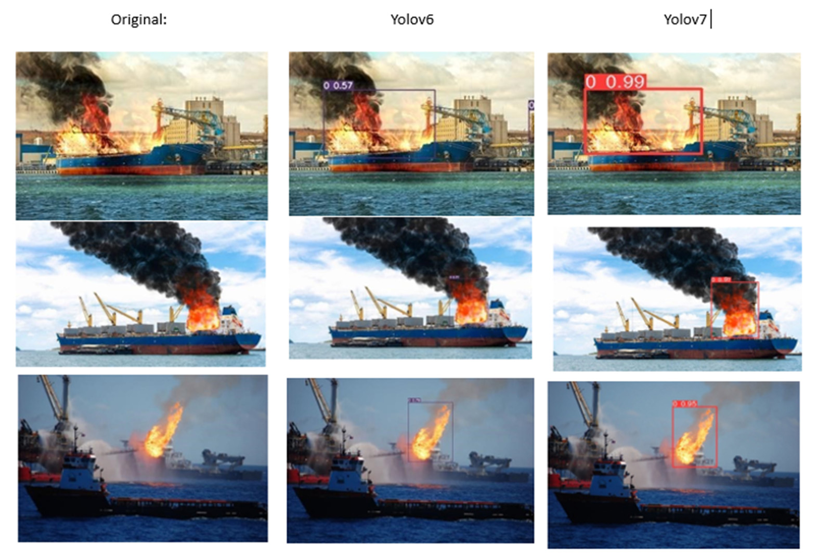

Slide 10
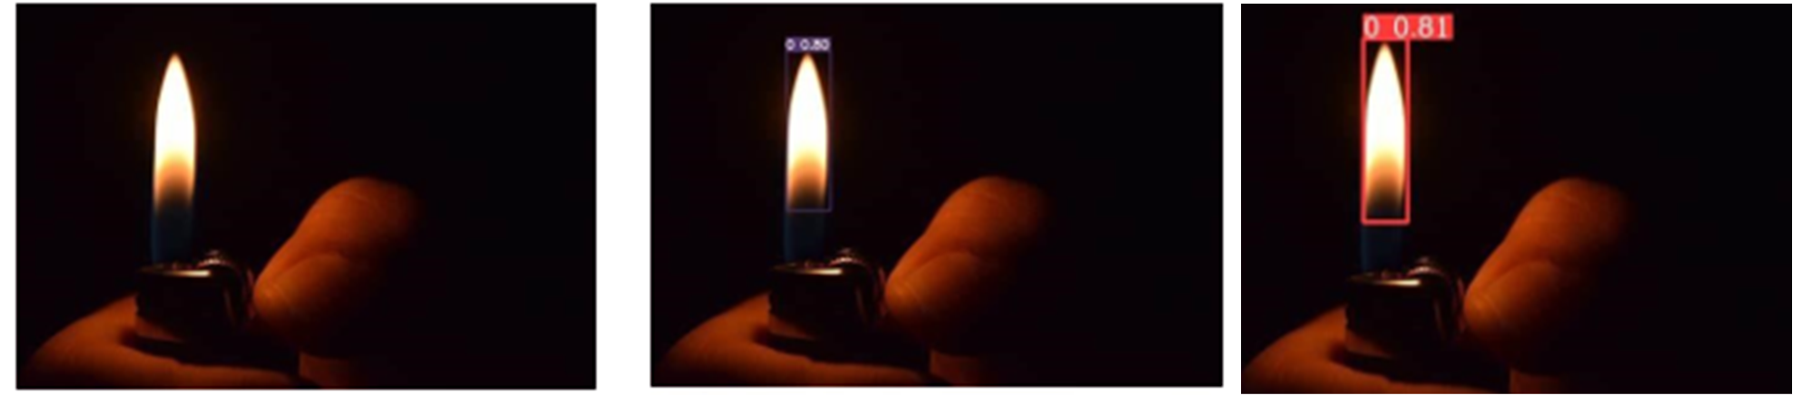

Slide 11
Conclusion
Thorough experiments and evaluation of the system demonstrate that the proposed system is highly efficient In detecting real-time fires in challenging environments.
Implementation of this model provides timely responses allowing the mitigation of fires before they escalate.
There is a significant contribution of YOLOv7 in leveraging the power of deep learning techniques to timely classify fire instance.

